Slide 1



Under the Hood of Alignment Algorithms for NGS Researchers
April 16, 2014
Gabe Rudy VP of Product Development
Golden Helix

Slide 2
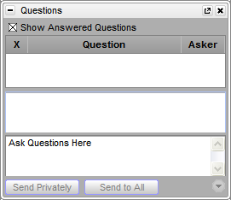
Questions during the presentation
?
?
?
Use the Questions pane in your GoToWebinar window

Slide 3
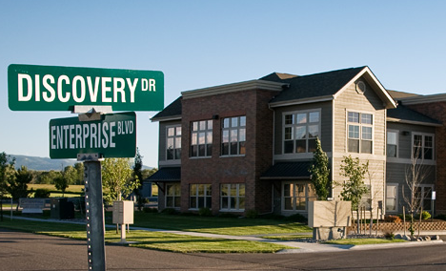
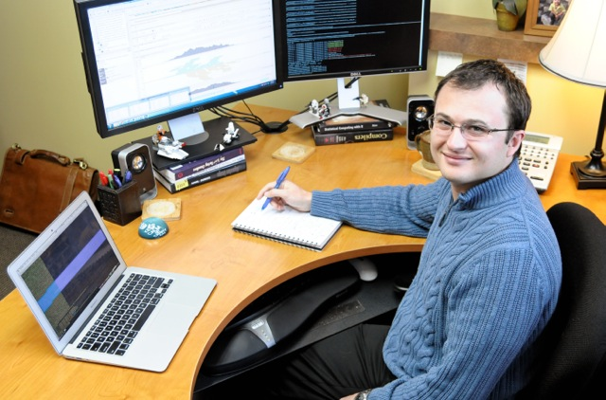
My Background
Golden Helix
Founded in 1998
Genetic association software
Analytic services
Hundreds of users worldwide
Over 800 customer citations in scientific journals
Products I Build with My Team
SNP & Variation Suite (SVS)
SNP, CNV, NGS tertiary analysis
Import and deal with all flavors of upstream data
GenomeBrowse
Visualization of everything with genomic coordinates. All standardized file formats.
RNA-Seq Pipeline
Expression profiling bioinformatics
Notes:
Experience comes from building secondary analysis pipelines for our services and RNA-seq purpose as supporting users of our downstream tools
Our tools start after secondary

Slide 4
Agenda
1
Alignment 101
2
A Brief History of Time
3
Know Your CIGAR
4
It’s All about the Variants
5
Q&A

Slide 5
Analytics and Sequencing
Primary Analysis
Analysis of hardware-generated data, machine stats etc.
Production of sequence reads and quality scores from raw optical data
Alignment
Secondary Analysis
QA filtering on raw reads
Alignment/Assembly of reads
QA and variant calling on aligned reads
Local Realignment
Tertiary Analysis “Sense Making”
Multi-sample processing
QA/QC of variant calls
Annotation and filtering of variants
Data aggregation
Population structure analysis
Genome browser-driven exploratory analysis
Phenotypic association testing
Variant Calling

Slide 6

Alignment 101
Notes:
Quick orientation
Go through examples in Ceph trio sheet

Slide 7
Agenda
1
Alignment 101
2
A Brief History of Time
3
Know Your CIGAR
4
It’s All about the Variants
5
Q&A

Slide 8
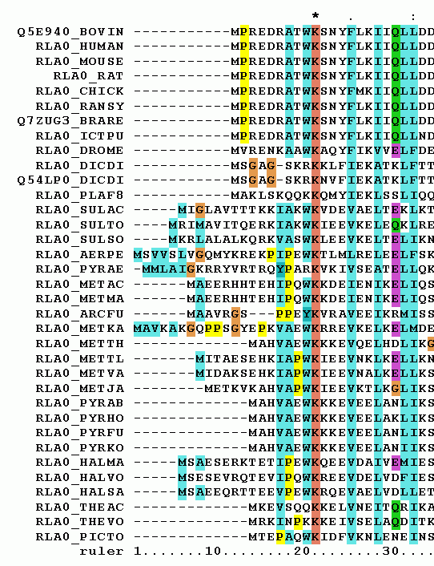

Types of Alignment
Multiple Sequence Alignment
Phylogenic analysis
Database Search (BLAST)
Pairwise Alignment
Local vs Global
Dynamic Programing vs Word Based
Notes:
Mention ethical matching of 1kg and NHLBI (I used European)

Slide 9
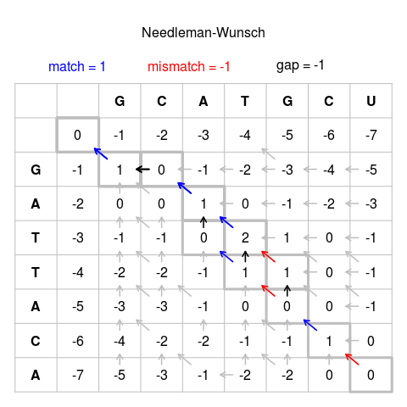
Pairwise Alignment with Dynamic Programming
Needleman-Wunsch (1970)
Dynamic programming optimal alignment of two sequences globally
O(n*m) space and time
Weighting function critical to define
Penalty matrix for mismatches
Penalty for gaps open and extensions (insertions, deletions)
Smith-Waterman (1981)
NW based piecewise (local) alignment
Many optimizations, still O(n*m)
Notes:
Global alignment tools create an end-to-end alignment of the sequences to be aligned. There are separate forms for protein or nucleotide sequences.
Local alignment tools find one, or more, alignments describing the most similar region(s) within the sequences to be aligned. (piecewise) There are separate forms for protein or nucleotide sequences. (Smith Waterman - 1981 - use dynamic programming to improve)

Slide 10
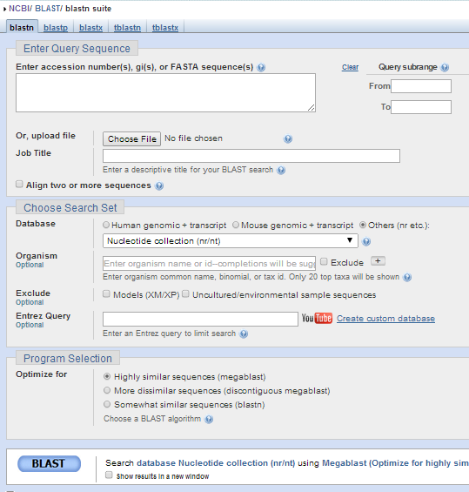
Pairwise Alignment with Word Methods
Heuristics methods based on finding matching k-tuples
Significantly more efficient when the majority of sequence will not match (database search, reference-based alignment)
FASTA (1985), BLAST (1990) designed for large DNA/Protein searches
New class of problem emerged with high-throughput sequencing

Slide 11
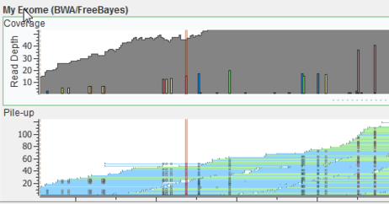
Alignment Versus Assembly
Assembly
Orders of magnitude slower and memory intensive than alignment
Potentially compare every read with each other O(n²)
Steps:
Merge overlapping reads into a de Bruijn graph
Simply the graph iteratively, construct contigs
Detangle with orthogonal tech (long reads, mates, optical mapping)
“Draft” genomes from short reads, have ~1kb sized contigs
Alignment
Requires a finished genome for your species (draft genomes possible, but of limited utility)
Precompute an index of the reference genome (can be costly as you do it once)
Each short read uses the index to find its best placements (potentially multiple)
Notes:
Examples: Velvet, SOAPdenovo

Slide 12
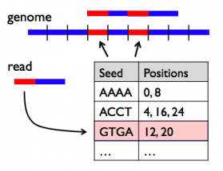
Hash Based Alignment Algorithms
Hash based
Pick k-mer size, build lookup of every k-mer in the reference to its positions
~16GB of RAM required for hg19
Seed-and-extend strategy
Popular tools:
BLAST: tunable for different uses
MAQ (2008): Heng Li, et al
NovaAlign: Slower, but very accurate
Isaac (2013): High mem, but fast
MOSAIK (2014): Hash clustering+SW
Notes:
MAQ a watershed paper, defining many of the logistical pieces taken for granted now “phred-scale” probabilities, usage of FASTA files. Also called SNPs
MOSAIK looks really interesting, used by 1000 genomes PhaseIII

Slide 13
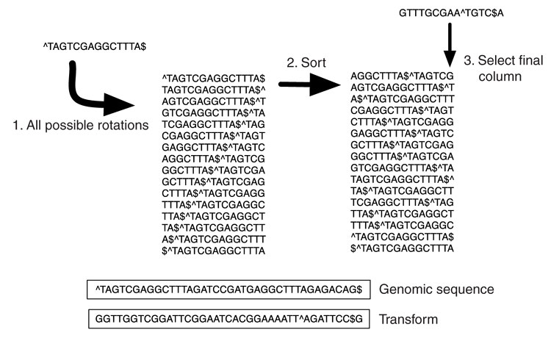
Burrows-Wheeler Transform
BWT is a reversible permutation of characters that can be used for fast substring-searching when used with an index

Slide 14
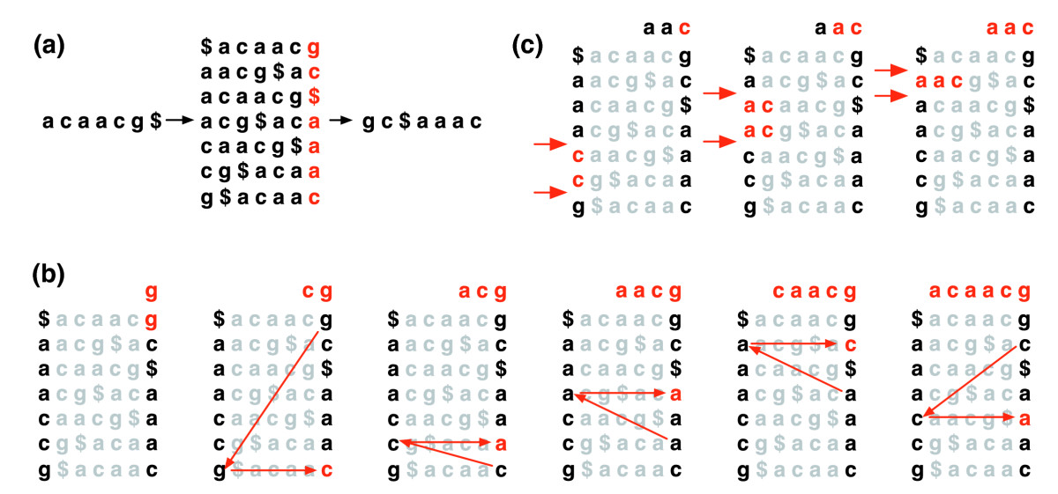
BWT

Slide 15
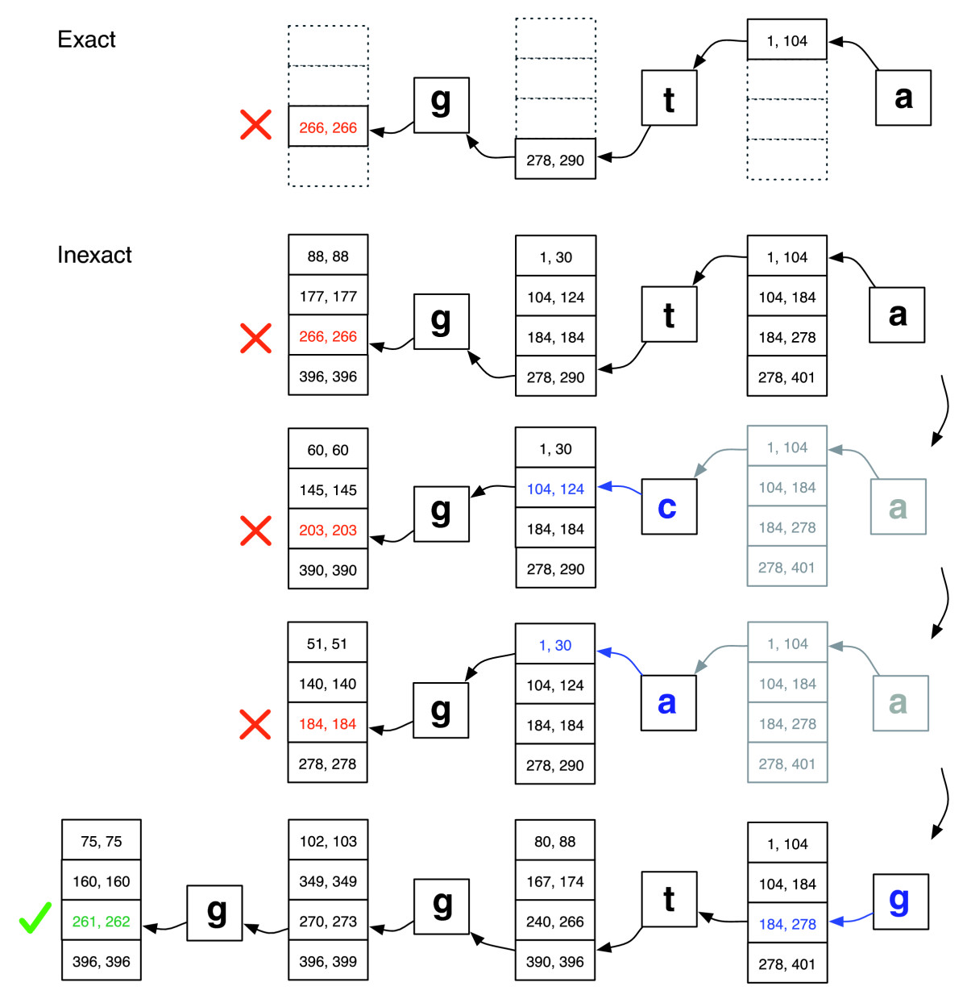
Backtracking – query ‘ggta’ with 1 mismatch

Slide 16
BWT Based Algorithms
Compute a FM index of the reference
Requires only ~1.5GB to hold in RAM of hg19
Requires a back-tracking algorithm to account for mismatches and gaps
Designed for speed
BowTie, BWA, SOAP2 (2009)
Order of magnitude less RAM and Time
More recent algorithms are often a hybrid:
BWA-SW (2010)
Bowtie2 (2012)
BWA-MEM (2013)
Notes:
Bowtie sent to publication in late 2009, published March 2009, BWA submitted Feb 2009, published May 2009

Slide 17
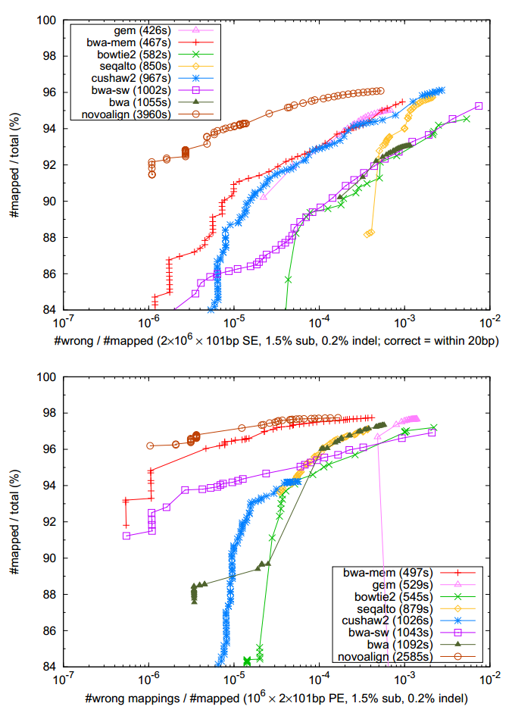
BWA and Friends
BWA (backtrack) - 2009
Very mature, handles short reads up to 100bp
BWA-SW (Smith Waterman) - 2010
BWA-MEM (Max Exact Matches) - 2013
>70bp read length recommended, but up to 1Mbp
Seed and extend with SW
Allowable error rate adjust with sequence length
Finds larger gaps
Faster! Generally supersedes BWA-SW

Slide 18
Algorithm Comparison
 | BWA | BWA-SW | BWA-MEM | Bowtie | Bowtie2 | NovaAlign | MOSAIK | Isaac | Tmap
Affiliation | Heng Li |  |  | U of Maryland |  | Novacraft | Boston College | Illumina | Ion Torrent
First Published | 2009 | 2010 | 2013 | 2009 | 2012 | - | 2014 | 2013 | -
Read Length | <100 | 70bp-1Mbp |  | <100 | >50
Gapped Alignments |  |  |  | No
Trimming |  |  |  | No
Error Rates Allowed | Low | High | Med | Low | Med | Med | High | Low | Med
Chim Reads | No | Yes | Yes | No | Opt | Opt | Yes | No | No
Mem Usage | Med | Med | Med | Low | Low | Low | Med | High | Med
Speed | Med | Med | Fast | Fast | Fast | Slow | Fast | Fast | Fast

Slide 19
Agenda
1
Alignment 101
2
A Brief History of Time
3
Know Your CIGAR
4
It’s All about the Variants
5
Q&A

Slide 20
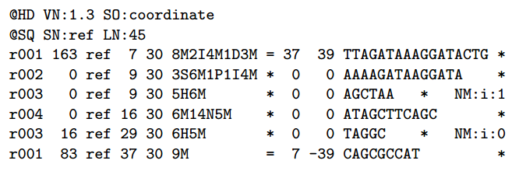
SAM/BAM
Spec defined by bwa/samtools author Heng Li, aka Li H, aka lh3.
SAM is text version (easy for any program to output)
BAM is binary/compressed version with indexing support
Alignment encoded in CIGAR code of matches, insertions, deletions, gaps and clipping
Can have any custom flags set by alignment tool (mix of standard and custom two-letter tags)
Key Fields
Chr, position
Mapping quality
CIGAR
Name/position of mate
Total template length
Sequence
Per-Base Quality Scores
Notes:
Show BAM header from CGI, versus Illumina versus IGN – why? There is useful information here (to bioinformaticians anway).
Samtools most common tool to merge/sort/filter

Slide 21
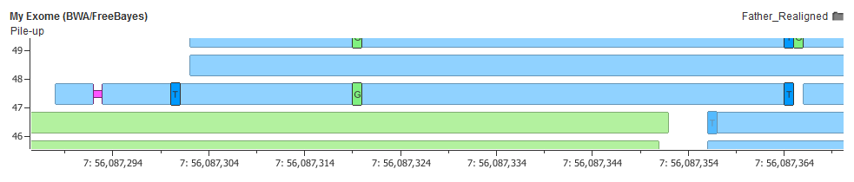
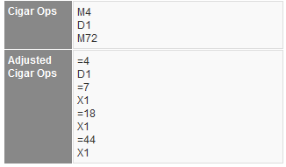
CIGAR String
Op | Description | Used
M | alignment match (can be sequence match or mismatch) | by default
I | insertion to the reference | InDel
D | deletion from the reference | InDel
N | skipped region from the reference | spanning intron
S | soft clipping (not-aligned) | per-base quality drops to threshold to trim read
H | hard clipping (not-present in reference) | chimeric reads, breakpoints, end of seq
P | padding (silent deletion from padded reference) | multiple sequence alignments (not common)
= | sequence match | when compared to ref
X | sequence mismatch | when compared to ref

Slide 22
Different Alignment Outcomes
Notes:
Quick orientation
Go through examples in Ceph trio sheet

Slide 23
Agenda
1
Alignment 101
2
A Brief History of Time
3
Know Your CIGAR
4
It’s All about the Variants
5
Q&A

Slide 24
Mapping and Calling Variants on the Human Genome
Classes of Confounders:
Issues with the Reference Assembly:
Sequence under-represented (exact match not in human reference, so get poor match)
Tiling issues creating artificial splices
Repeated regions and Low Mapping Quality Regions:
Over 50% of the genome is repetitive
Low sequence “complexity” or “information density” means short reads cannot uniquely map. “Mappability”
Interference with larger classes of variation: Structural Variation
Calling genotypes of SNPs/short-InDels in a deletion
Inversion/Translocation/CNV break points
Disagreement in Representing Complex Variants

Slide 25
Responsibility of the Alignment Algorithm?
Placing reads in the right part of the genome
Providing accurate mapping quality scores
Often need to empirically train an aligner to produce Gaussian spectrum of scores
Providing the best data to variant callers
What Variant Callers expect?
Multi-mapped read status (often filtered out by MQ=0)
Mate-pair mapping information
Just “localizing” the read?
Consistently described gapped alignments?

Slide 26
GRCh38 – Here Now, but still Waiting
A better human reference
Revised Cambridge Reference Sequence (rCRS) MT
Has centromere models
~2000 incorrect alleles fixed
~100 assembly gaps updated
No Gene Annotations
RefSeqGene - Feb 2014
Ensembl Q4 2014
No Variant Annotations
Re-align 1000 Genomes and NHLBI 6500?
dbSNP?
331,824
319,442
 | GRCh37 | GRCh38
Ts/Tv | 2.06558 | 2.10171

Slide 27
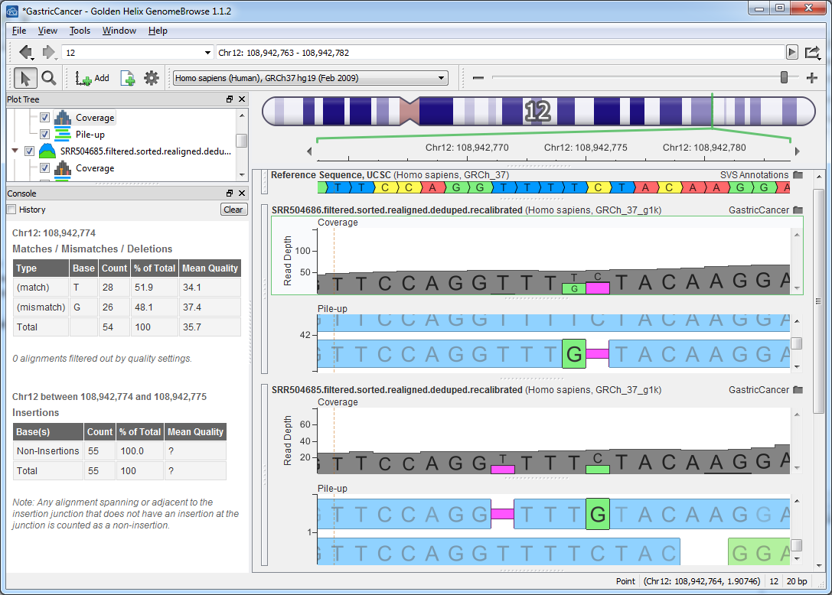
InDel Alignment: Watch for ambiguities

Slide 28
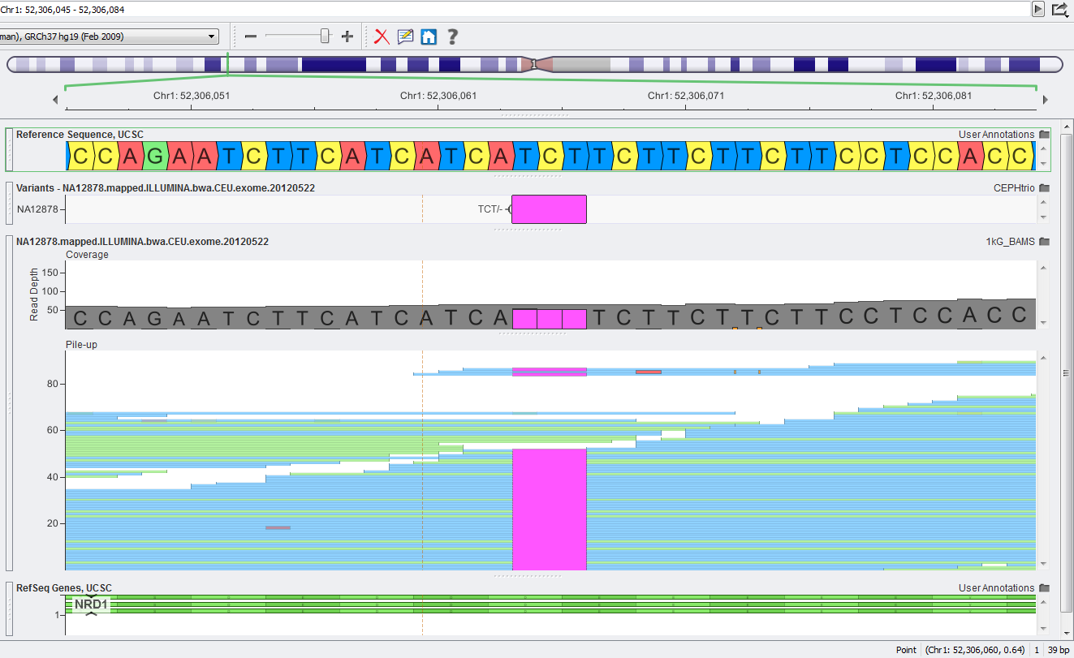
InDel Alignment: Watch for repeats and read ends

Slide 29
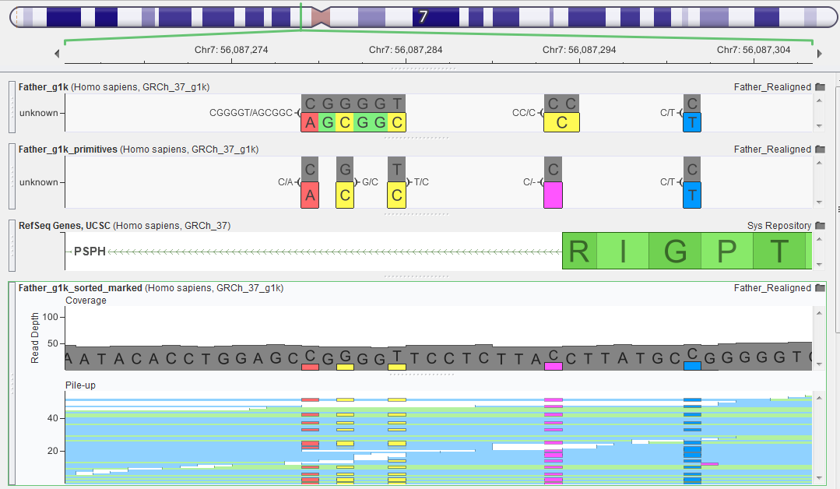
MNP vs Allelic Primitives

Slide 30


Genome In a Bottle
NIST Sponsored, Community Effort
NA12878 cell line, sequenced many platforms, read lengths and sample preps
Create “ensembl” variant call set
Create many making regions
Regions not able to make consensus call
Repeat and low-complexity regions
SV in NA12878
Variants, BED and alignment data available
Justin Zook

Slide 31
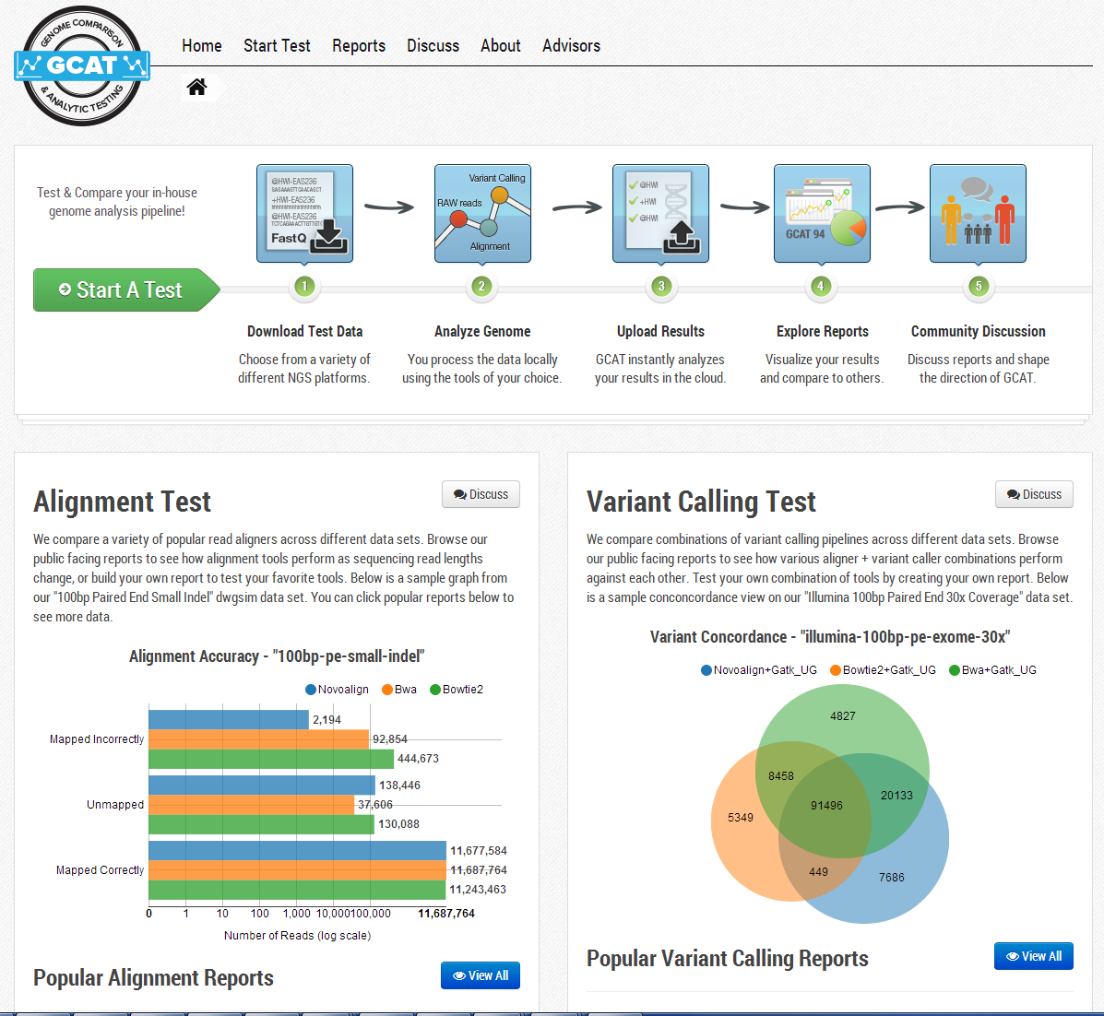
Resources
GCAT
Benchmarks
Alignment
Variant Calling
GIAB Truth Set
Various bench samples
Interactive filtering

Slide 32
Some GIAB Examples
Notes:
http://www.bioplanet.com/gcat/reports/270/variant-calls/illumina-100bp-pe-exome-150x/novoalign-freebayes-q40/compare-571-180/group-read-depth

Slide 33
Questions?
?
?
?
Use the Questions pane in your GoToWebinar window

